Slide 1
Week 8 Presentation

Slide 2
Normalisation
Fixed issue with normalisation not working as intended on noise
Trouble getting similar model performance when normalising input data
Tried changing:
Number of layers
Amount of training data
Input sequence length
Batch normalization
Can try changing weighting parameters in loss function, or dropout probability

Slide 3
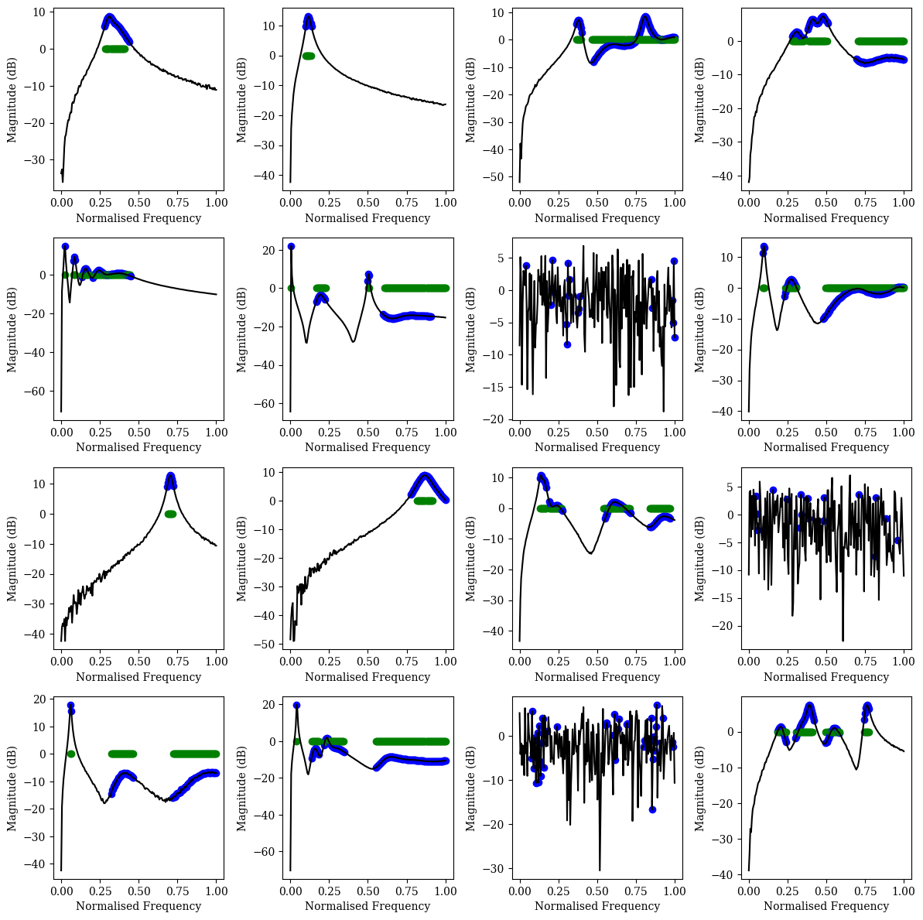

Slide 4
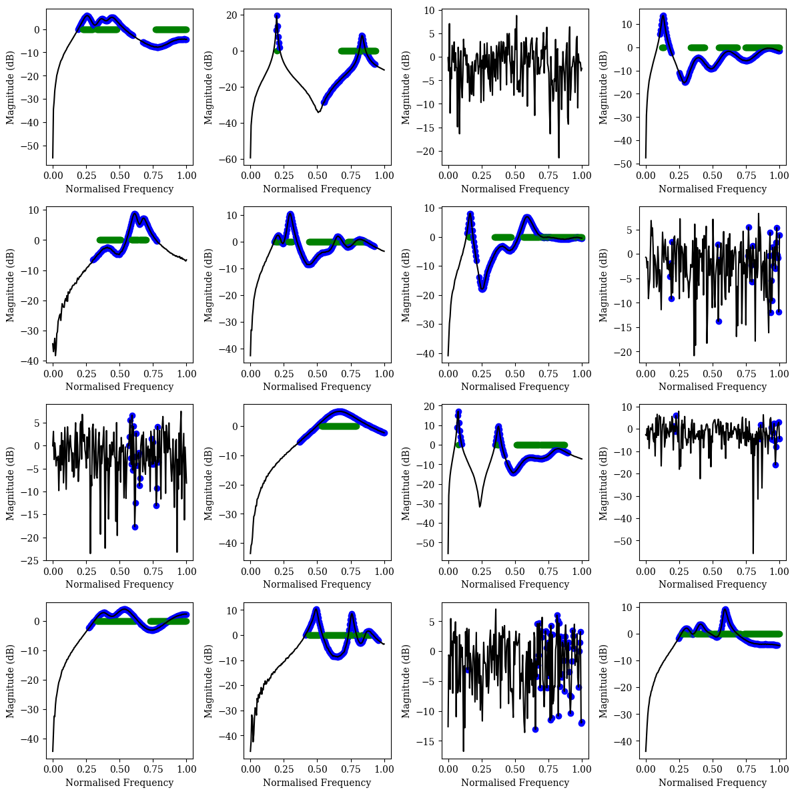

Slide 5
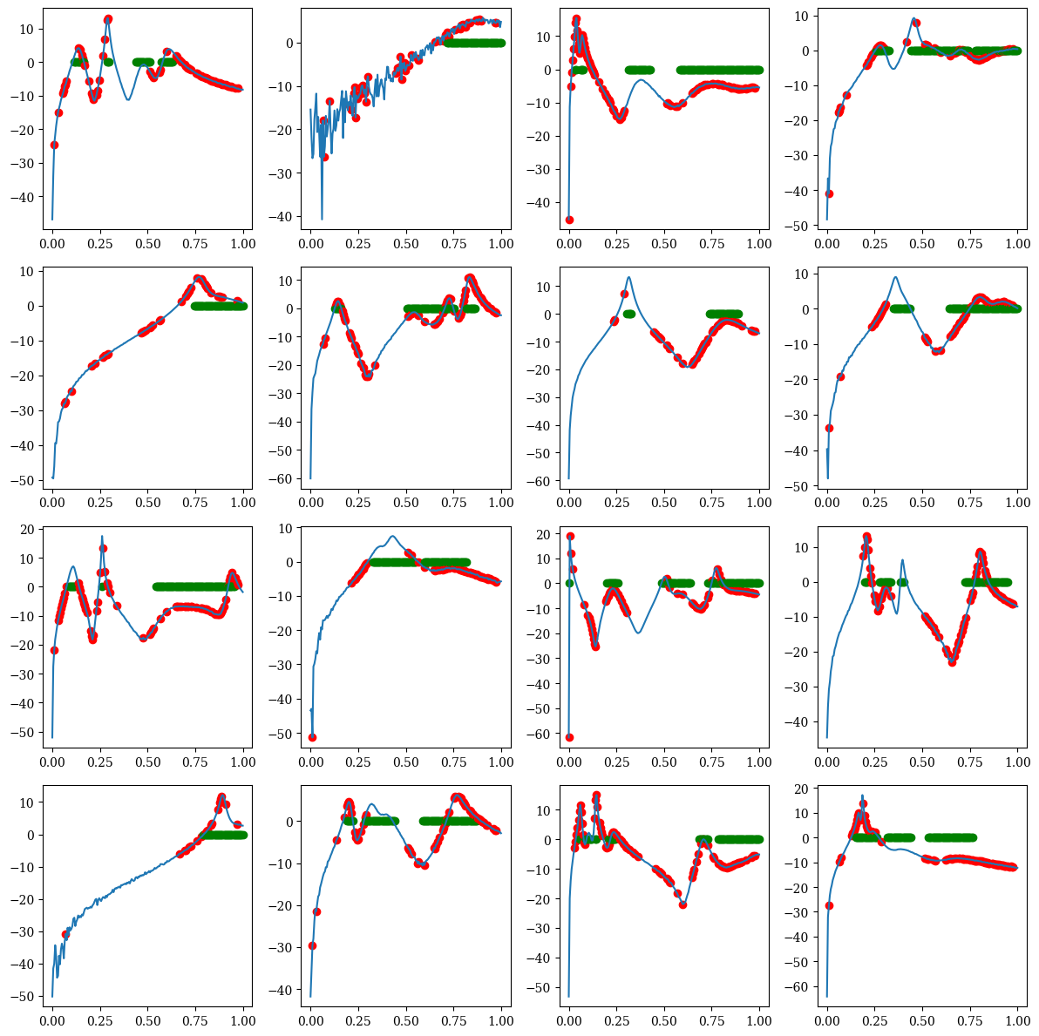
With Batchnorm

Slide 6
Other things
Refactored code to make it more usable
Presentation
Technical milestone report

